Slide 1
Credit scoring in microfinance
Course - Data Analytics (CS664)
Group members - Abhishek Tiwari and Shubham Jain

Slide 2
WHAT IS CREDIT SCORING ?
How it is use full?
Which business generally uses credit scoring?

Slide 3
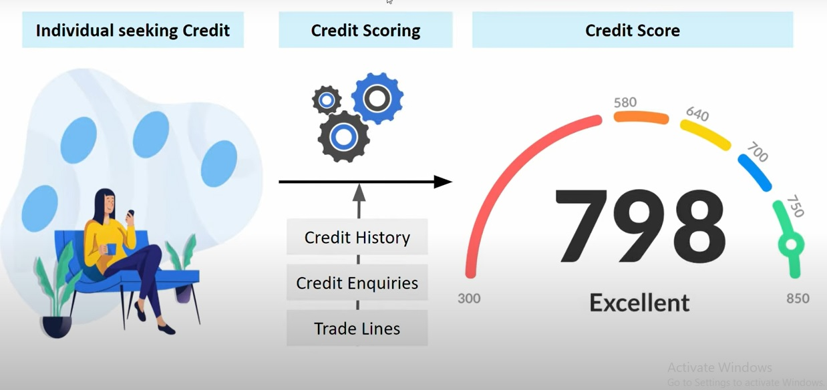

Slide 4
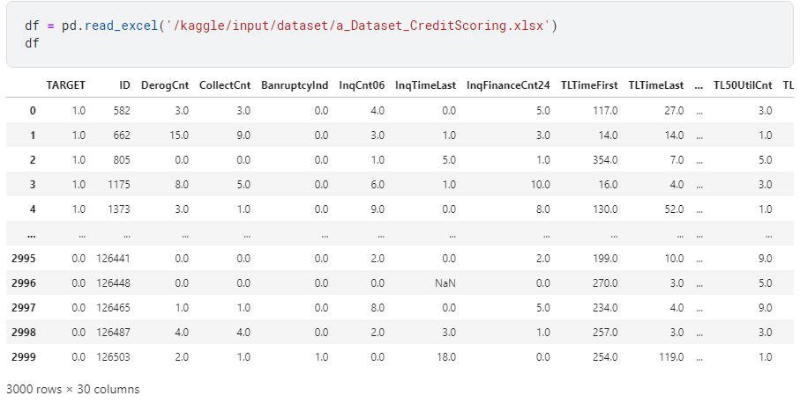
We have taken Dataset from Kaggle

Slide 5
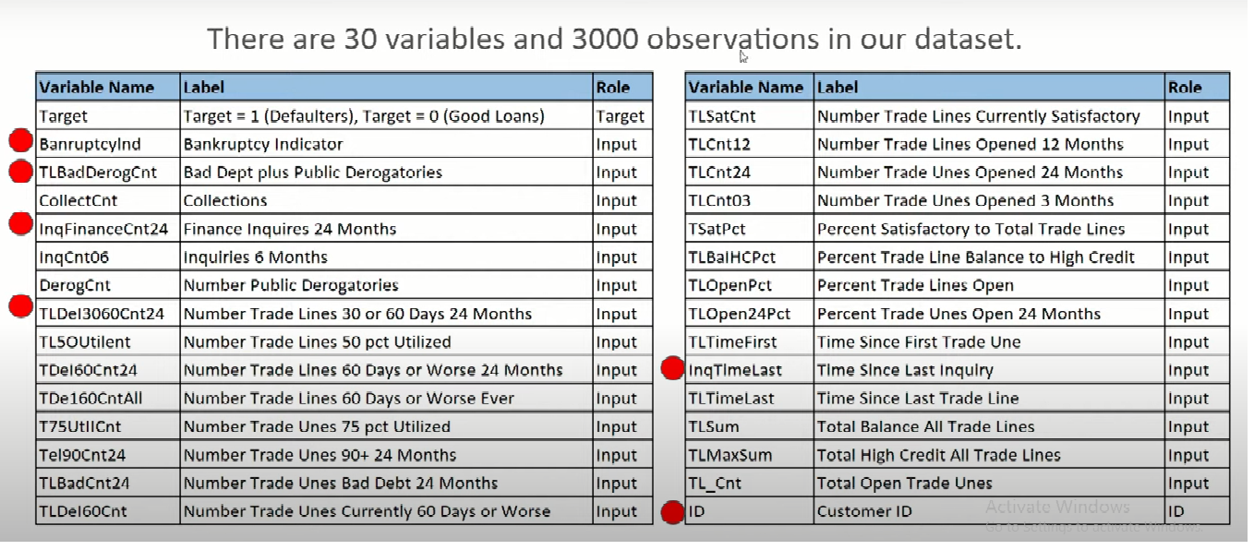
Columns description

Slide 6
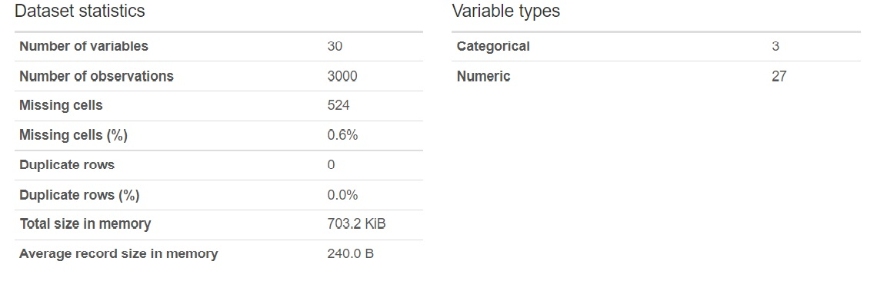
Dataset statistics

Slide 7
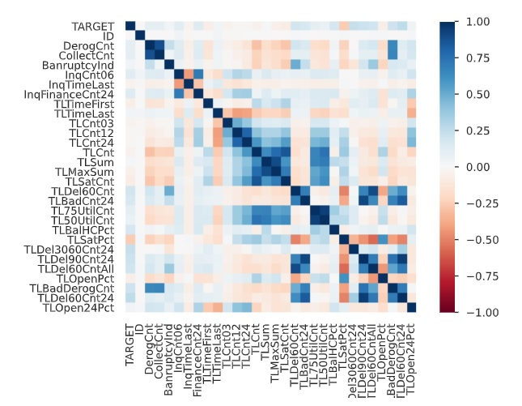
HEATMAP

Slide 8
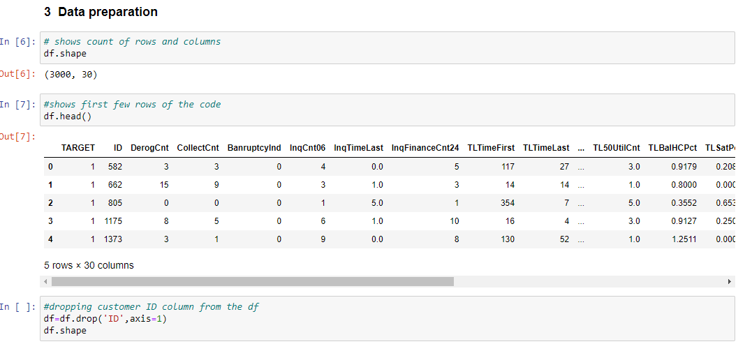
Data size

Slide 9
Information value
Information Value analysis is a data exploration technique that helps determine which columns in a data set have predictive power or influence on the value of a specified dependent variable.
Information value analysis is a popular tool for banks, for example, providing a set of variables that help determine which credit card customers are most likely to default.

Slide 10
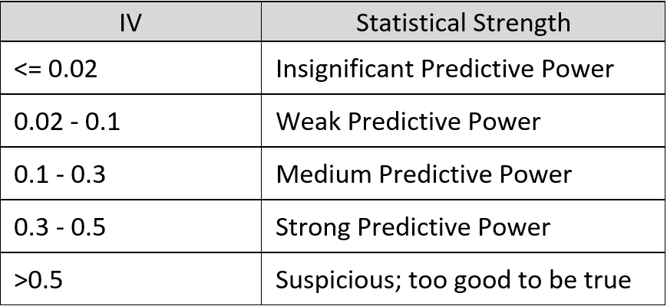
Table

Slide 11
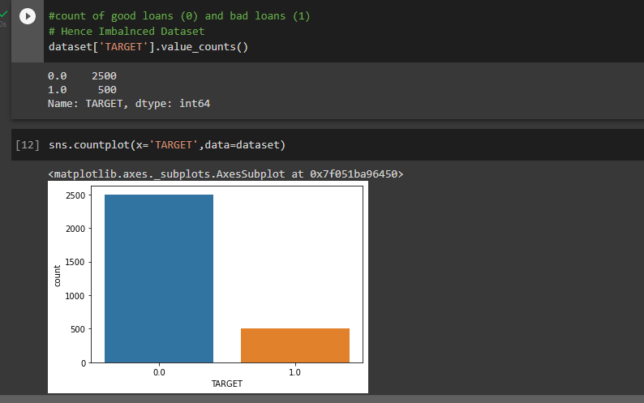
Sampling technique for IMBALANCED DATASET

Slide 12
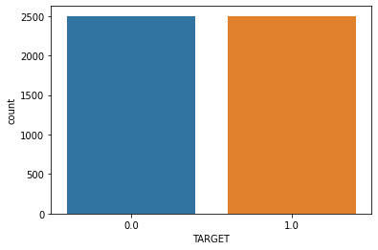

Slide 13
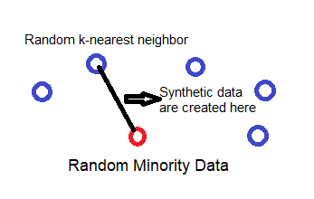
Synthetic Minority Oversampling Technique, or SMOTE for short.
SMOTE works by utilizing a k-nearest neighbour algorithm to create synthetic data. SMOTE first start by choosing random data from the minority class, then k-nearest neighbours from the data are set.

Slide 14
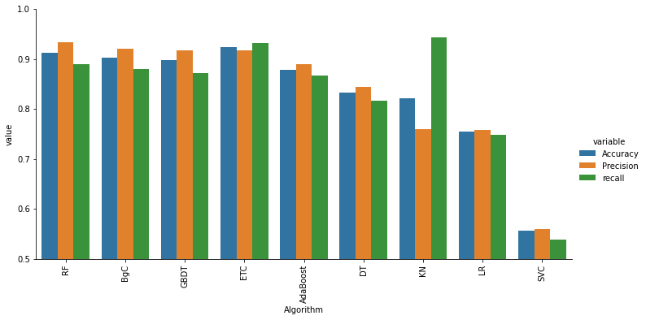
Comparison between different algorithms

Slide 15
